Slide 1

INVESTIGATING HOUSING PRICE IN SYDNEY TO IDENTIFY CRITICAL FACTORS OF PRICE FLUCTUATION
Research student: Nyamdorj Dorjsuren
Research supervisor : Mohammad Mojtehadi
Sydney, NSW May, 2019
Notes:
You can safely remove this slide. This slide design was provided by SlideModel.com – You can download more templates, shapes and elements for PowerPoint from http://slidemodel.com

Slide 2
01
Motivation
Economic justify
02
Research question
Three question
03
Literature review
Past, present and future
Outline of thesis
04
Methodology
Three different analysis
5 chapter, 28 sub-chapter
05
Data collection
Secondary and primary data
06
Findinds
Forecast, macro and micro factors
07
Conclusion
Useful research
08
Recommendation
For APIC future researchers

Slide 3
Motivation of research
Peak price
13% of real GDP of Australia is construction industry included property
About 1.3 million Australian residents, plus international people who live Sydney are work in that industry
Housing price had been increased 25 years until 2016
Peak housing price in 2016
Price dropped rapidly (~30%) in last 2 years

Slide 4
Literature review
Housing price in the past
Current housing price and situation
Predicted housing price
Affecting the factors

Slide 5
Research questions
Q1. Forecast of housing price in Sydney for next 5 years, to compare more than two different methods
Q2. What macro factors affect the housing price in Sydney
Q3. What micro factors affect the housing price in Sydney

Slide 6




Methodology and data
Research question | Data source | Tools, methods | Equations
Q1. Forecast of housing price in Sydney for next 5 years, to compare more than two different methods | Secondary data. Last 20 years housing price applied. Source is www.homely.com.au. | •Holt’s linear trend method •Simple Exponential Smoothing method •Moving average method
Q2. What macro factors affect the housing price in Sydney | Secondary data, www.abs.com.au and web site of Domain Group and some reliable source applied. | •Correlation analyse •Multiple regression analyses
Q3. What micro factors affect the housing price in Sydney | 100 randomly sampled primary data will be applied. Source is web site of Domain Group | •Descriptive statistics •Multiple regression analyses •Hedonic regression analysis
$${\hat{y}}_{T+h|T}=\frac{1}{T}\sum_{t=1}^{T}{y_{t}}$$
$\hat{y}=b_{0}+b_{1}x_{1}+b_{2}x_{2}$+…+$b_{n}x_{n}$
$$P_{H}=P\left(X∈S, A, C, R, CH\right)$$
$$P_{H}=e^{bX+e}$$

Slide 7
Methodology and data
Research question | Variables | Code | Software
Q1. Forecast of housing price | Y (Independent) - Housing price X (dependent) - time | Yearly price | MS Excel -2016
Q2. What macro factors affect the housing price in Sydney | Y (Independent) - Housing price X1 – Real GDP X2 – Inflation X3 – Mortgage X4 – Home income X5 - Unemployment | Yearly price, Rates | MS Excel -2016
Q3. What micro factors affect the housing price in Sydney | Y (Independent) - Housing price X1 - Size of dwelling (1m2) X2 - A distance between Sydney Tower and dwelling (1 km) X3 - A distance between train station and dwelling (1 km) X4 - A distance between shop or retails and dwelling (1 km) X5 - Surrounded by safety environment area (within 1 km) X6 - Located in “A” Zone suburbs (within 1 km) X7 - Dwelling surrounded by noisy facilities (within 1 km) X8 - Internal and external design and furnished as standards X9 - Dwelling has few neighbours | Yearly price, Dummy variables 1 – Yes 0 - No | SPSS 20

Slide 8
5 years forecast
Housing price
2018 - $833876
Forecast
3.8% increase, 2019
3.7% increase, 2020
3.5% increase, 2021
Constant, 2022
3.4% increase, 2023
Historical housing price in Sydney since 1999
 | Holt’s method | Simple smoothing | Moving average
Forecast 2019 | 3.8% | 1.2% | 13.4%
Forecast 2020 | 3.7% | -0.01% | -1.0%
Forecast 2021 | 3.5% | 0.00% | -4.7%
Forecast 2022 | 0.0% | 0.00% | 0.4%
Forecast 2023 | 3.4% | 0.0% | 2.2%
MAP Error | 0.08 | 0.127 | 0.31

Slide 9
Regression analyze between housing price and macro factors
R square is 94.5%.
All of macro factors strongly effect the housing price in Sydney

Slide 10
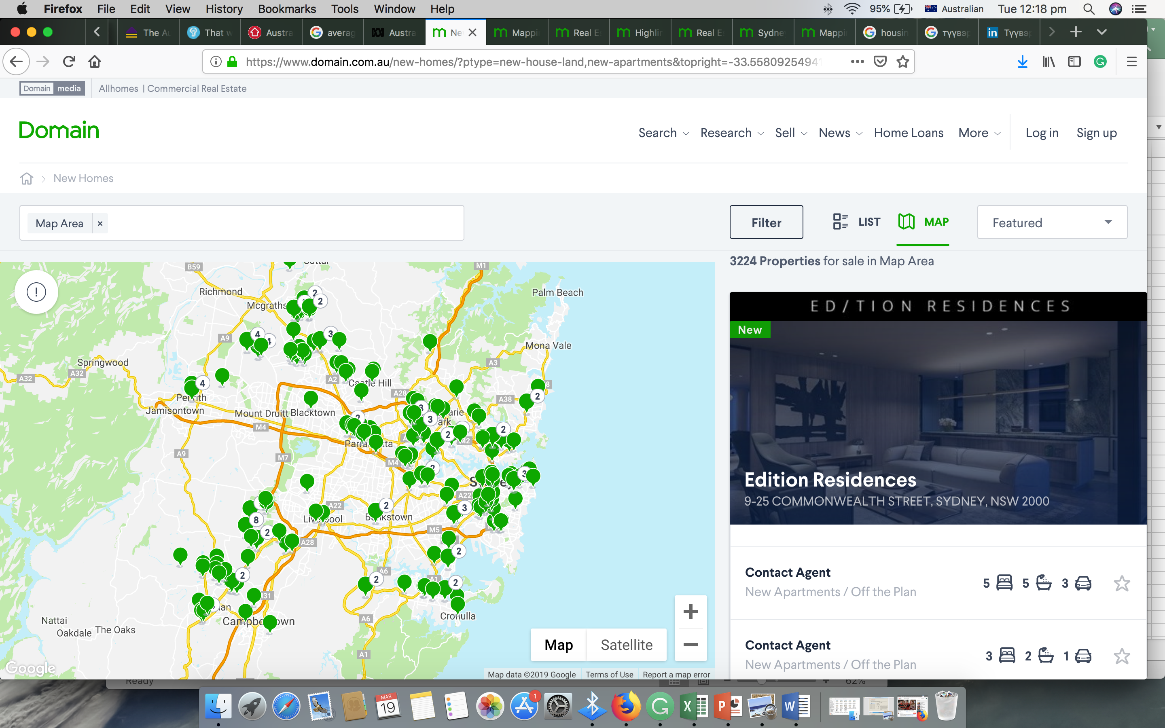
Data set from Domain group
Sampling
Size data set was 3200 new house and unit in Sydney, 2018
Randomly selected sampling size is 100

Slide 11
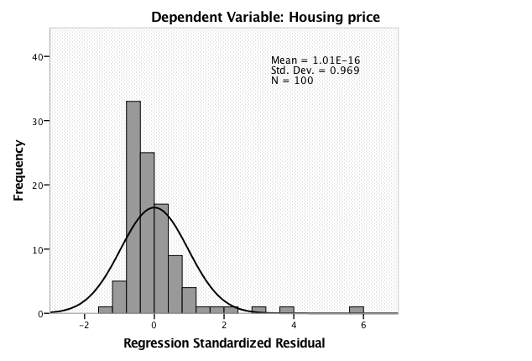
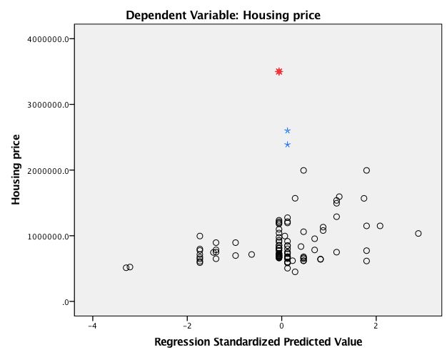
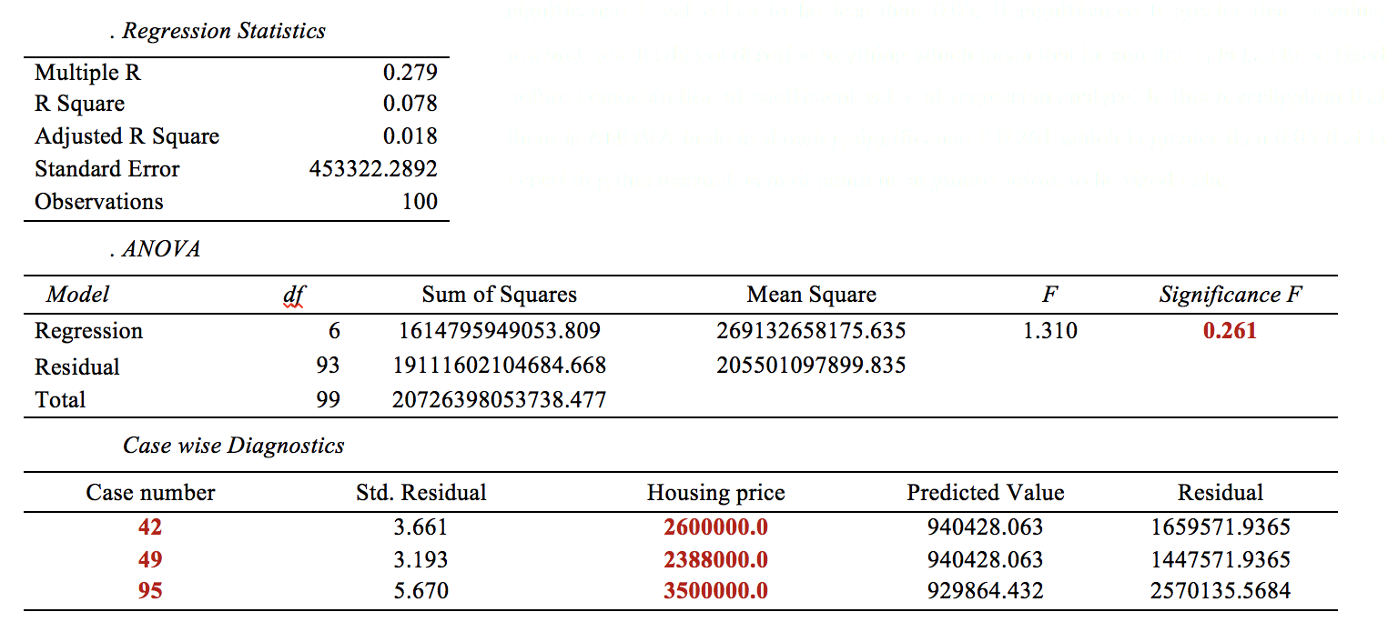
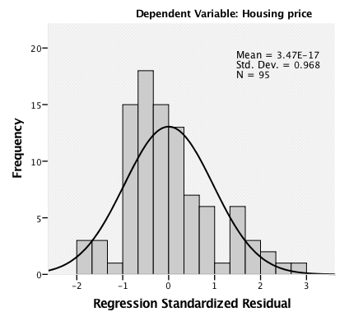
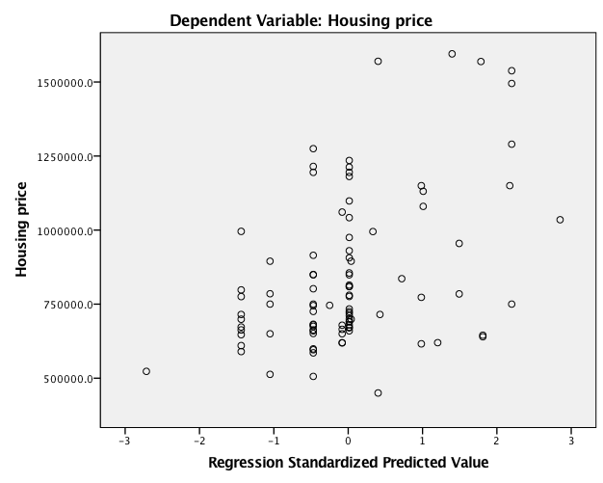
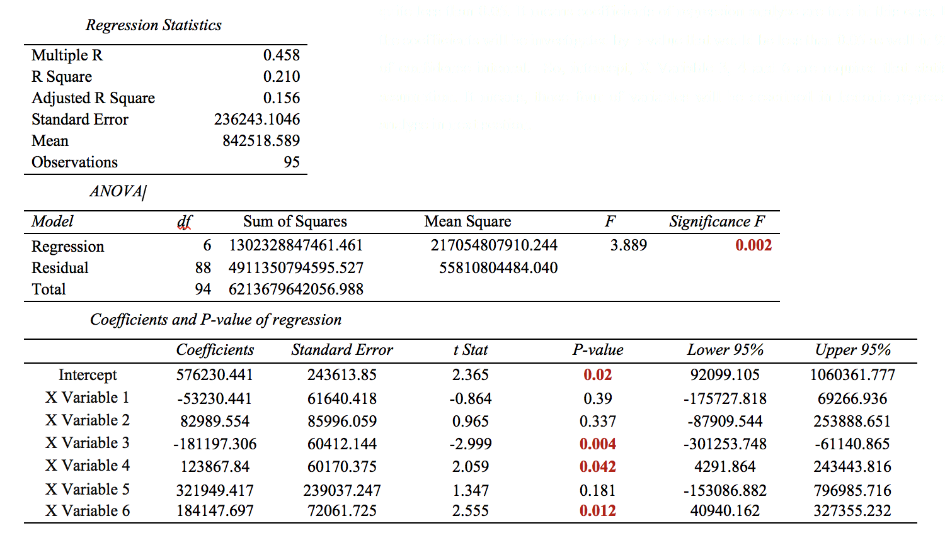
Multiple regression
Histogram
Scatterplot
Scatterplot

Slide 12
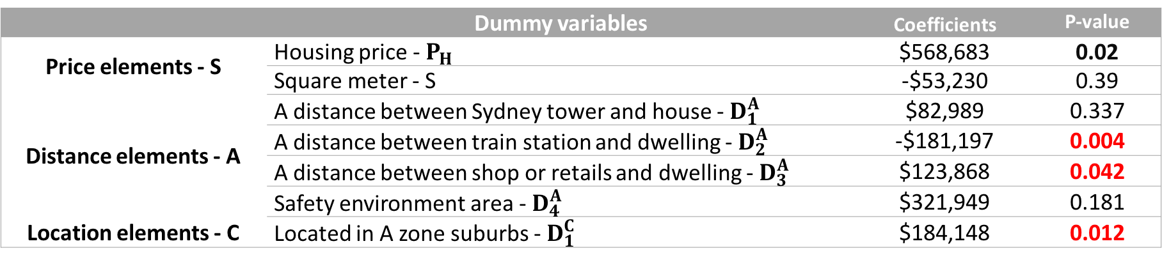
What micro factors affect the housing price / hedonic model
 | Dummy variables | Coefficients | P-value
Price elements - S | Housing price - $P_{H}$ | $568,683 | 0.02
 | Square meter - S | -$53,230 | 0.39
Distance elements - A | A distance between Sydney tower and house - $D_{1}^{A}$ | $82,989 | 0.337
 | A distance between train station and dwelling - $D_{2}^{A}$ | -$181,197 | 0.004
 | A distance between shop or retails and dwelling - $D_{3}^{A}$ | $123,868 | 0.042
 | Safety environment area - $D_{4}^{A}$ | $321,949 | 0.181
Location elements - C | Located in A zone suburbs - $D_{1}^{C}$ | $184,148 | 0.012
$$P_{H}= e^{\$568,683 – \$181,197D_{2}^{A} + \$123,868 D_{3}^{A} + \$184,148 D_{1}^{c}}$$
1. Train station affects to decrease the housing price by $181 per square meter when it locates a way
2. Shops affect to increase the housing price by $123 per square meter when it locates a closer
3. A zone suburbs affect to increase the housing price by $184 per square meter when it locates a closer

Slide 13
Conclusion
Conclusion
Affecting Macro factors
Affecting Micro factors
Will be increased in next 5 years
Mortgage
GDP
Train station
Inflation
Housing price
in Sydney
Shops, retails
Unemployment
A zone suburbs
House income

Slide 14
Recommendation for future research
Macro factors have been studied limited, able to extend
Cost of construction
Housing boom
Land price
Mortgage system
Micro factors, able to extent sampling size and range
Whole Australia
Or specific area
Single suburbs
Housing price forecast, able to separate
Housing price
Unit price

Slide 15
References
Aussie n.d, 25 years of housing trends, Aussie, viewed 20, March 2019, https://www.aussie.com.au/home-loans/property-reports/25years.html
Australian Bureau of Statistics 2015, Housing Occupancy and Costs, 2013-14, cat. no. 4130, viewed 21, March 2019, http://www.abs.gov.au/Ausstats/abs@.nsf/Previousproducts/4130.0Glossary12013-14
Burke, K 2018, Sydney property price declines tipped to halt next year before plateau and gradual rise, report suggests Domain, viewed 18, March 2019 https://www.domain.com.au/news/sydney-property-price-declines-tipped-to-halt-next-year-report-suggests-787959/
Burke, K 2019, Sydney house prices fall 9.9 per cent in 2018: Domain report, Domain Group, viewed 18, March 2019, https://www.domain.com.au/news/sydney-house-prices-fall-9-9-per-cent-domain-report/
Farrer, M 2019, Melbourne and Sydney house prices plunge further in January, The Guardian, viewed 18, March 2019, https://www.theguardian.com/australia-news/2019/feb/01/melbourne-sydney-property-prices-plunge-january
Homely, 2017, What’s really behind Australia’s soaring house prices? Part 1, Homely, viewed 18 March 2019, https://www.homely.com.au/news/property-news/whats-really-behind-australias-soaring-house-prices-part-1
Hyndman, J, Athanasopoulos, G 2018, Forecasting: Principles and Practice, Monash University, Australia, viewed 18, April 2019, https://otexts.com/fpp2/
Khanal, R 2018, ‘Week 2: Chapter 1, Introduction of business decision analysis’ Lecture PowerPoint slides, SBM 1108: Business decision analysis, Asian Pacific International College, viewed 05 March 2018, http://ols.apicollege.edu.au/

Slide 16
References
Kohler, M, Merwe, M 2015, Long-run Trends in Housing Price Growth, Reserve Bank of Australia, viewed 4 March 2019, https://www.rba.gov.au/publications/bulletin/2015/sep/pdf/bu-0915-3.pdf
Morris, B, 2017, What we can learn from Australia’s median house prices from 1970-2016, Homely, viewed 18 March 2019, https://www.homely.com.au/news/property-news/australias-median-house-price-from-1970-2016
Nguyen, J, 2017, 4 key factors that drive the real estate market, Investopedia, viewed 5 March, 2019, https://www.investopedia.com/articles/mortages-real-estate/11/factors-affecting-real-estate-market.asp
Mojtahedi, M 2019, ‘Session 11: “Regression analyses (continued)” Lecture PowerPoint slides, SBM 1206: Advanced risk and uncertainty management, Asian Pacific International College, viewed 18 April 2018, http://ols.apicollege.edu.au/
Petteinger, T 2017, Factors that affect the housing market, Economics help, viewed 18, April 2019, https://www.economicshelp.org/blog/377/housing/factors-that-affect-the-housing-market/
Rent, 2018, Australia’s cheapest (and most expensive) suburbs revealed, Rent.com.au, viewed 15 March 2019, https://www.rent.com.au/blog/rental-prices-december-2018
Verrender, J 2019, Sydney buyers continue to splash cash on Central Coast weekenders, Real Estate Group, viewed 18, March 2019, https://www.realestate.com.au/news/sydney-buyers-continue-to-splash-cash-on-central-coast-weekenders/
Yardney, M 2018, Property Investment In Sydney – 20 Market Insights, Propertyupdate.com.au, viewed 18, March 2019, https://propertyupdate.com.au/property-investment-sydney/
Yardney, M 2018, Property predictions for 2021 revealed, Property update, viewed 18, March 2019, https://propertyupdate.com.au/property-predictions-for-2021-revealed/

Slide 17
Thank you

